Slide 1
Lead Scoring Case Study
Souvik Ganguly, Megha Rajagopal

Slide 2
Case Study
Client: X Education
Profession: Selling online courses to industry professionals
Problem statement: Although X Education gets a lot of leads, its lead conversion rate is very poor. We need to help them select the most promising leads, i.e. the leads that are most likely to convert into paying customers. Target lead conversion rate is expected to be around 80%.

Slide 3
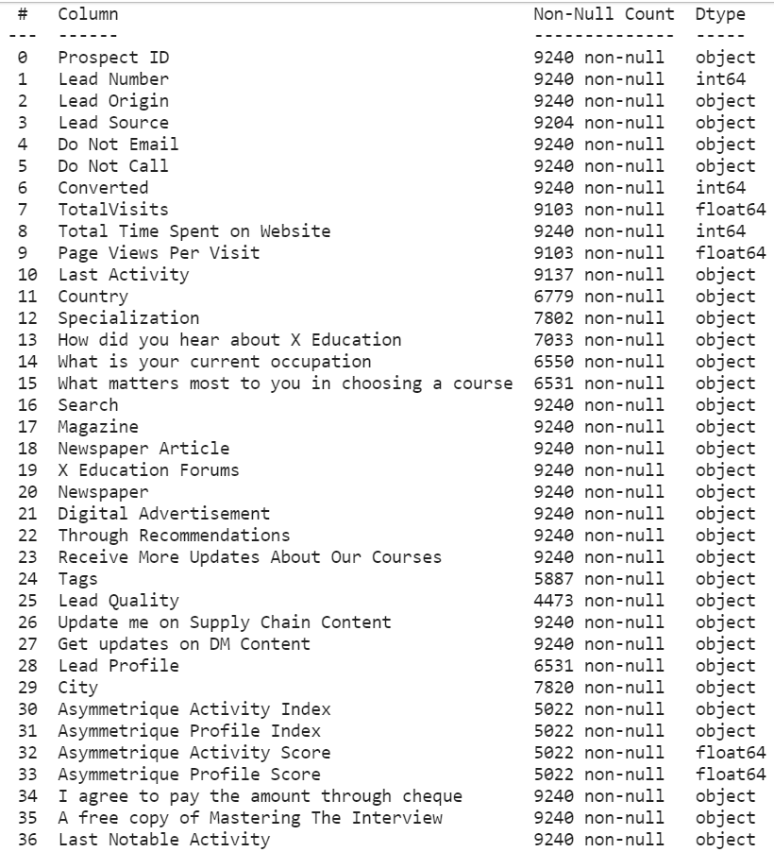
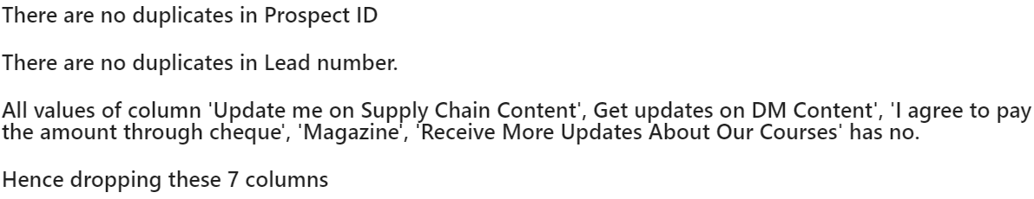
Data Inspection and Cleaning
We began with a general inspection of the data set – datatypes, number of records, columns and the values present in them.
Here, we observed the identity columns have no bearing on our study, so we removed them.
Also, certain columns were either entirely or very strongly biased towards a single value. So, we removed these too as they were not useful in deriving any insights relevant to our model.
We also checked and treated null values and outliers in the columns.

Slide 4
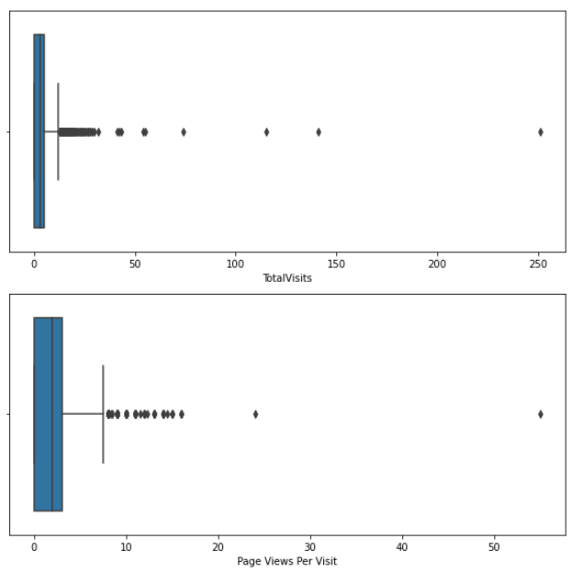
Null values and Outliers
Here, we observed a few columns had both null values and the option ‘Select’ which translated to no option being selected for that particular attribute for the customer.
Treating these as null in addition to the already present empty values, we removed the columns with high percentage of nulls.(>40%)
The columns with lower values of nulls were treated accordingly i.e. using mode, custom values etc. Certain columns were retained keeping in mind the business significance.
The outliers were treated by IQR method.

Slide 5
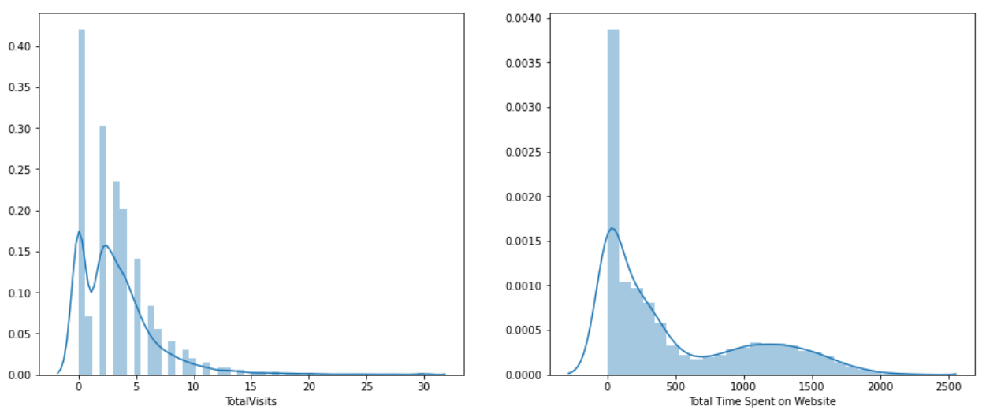
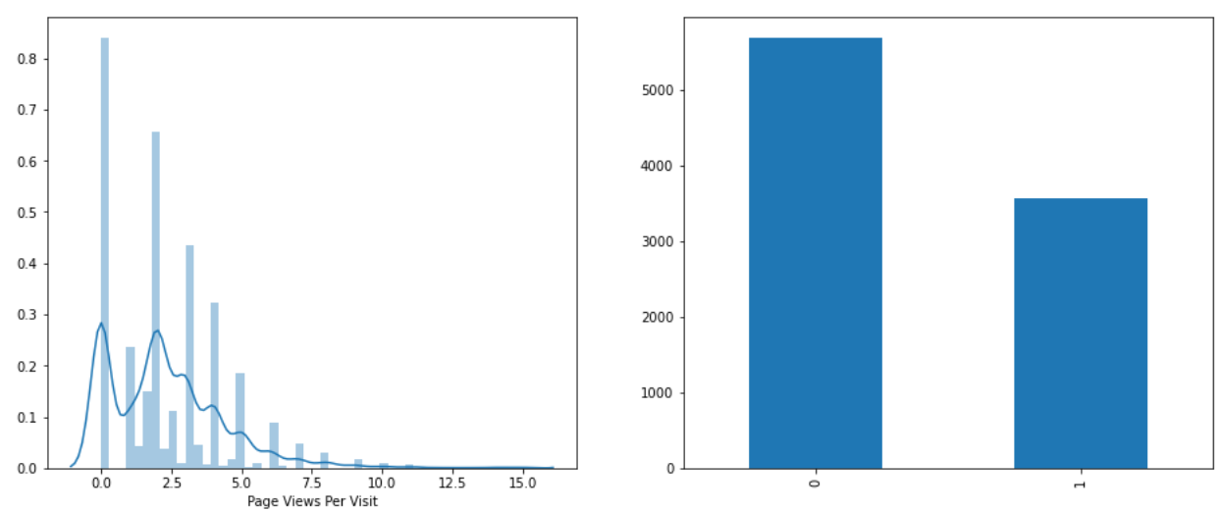
EDA – Univariate Analysis
Total Visit data is positively skewed. Most of our data has a Total Visit between 0-4.
Total Time spent on website is positively skewed as well. Most of our data spends a total time from 0-400 units.
Again Page views per visit is positively skewed. The average Page views per visit is 2.36 units and most of our data lies in the range of 0-3.
The spread of target variable seems good for classification.

Slide 6
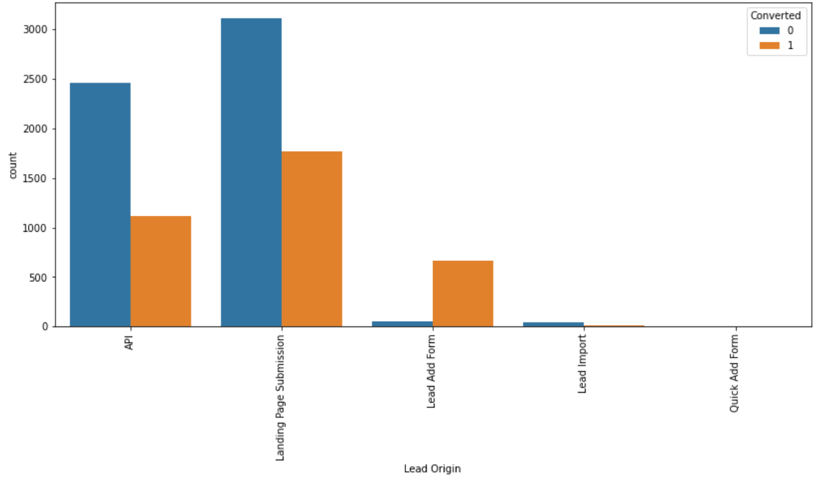
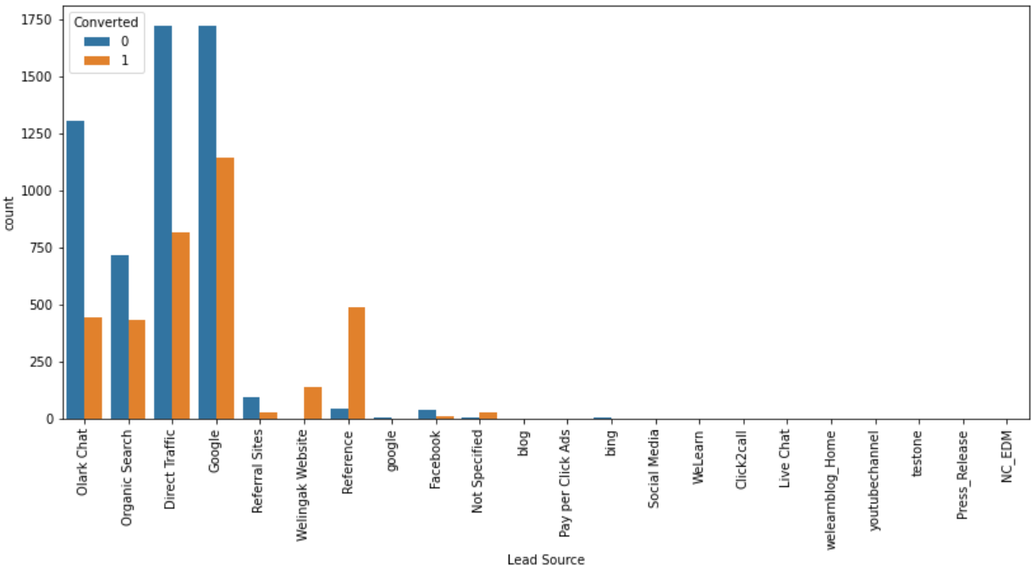
EDA – Bivariate and Multivariate Analysis
Lead Origin has been highest with Landing Page Submission both for converted and non-converted categories followed by API. The ratio of non conversion to conversion is greater than 1.
The best lead sources were Direct traffics and Google where the better ratio of non conversion to conversion is given by Google. Good lead sources(less than the best) are Olark Chat, organic chat and through references. In these cases Olark chat and organic search has a positive non conversion to conversion but lead sources through references have the best non conversion to conversion ratio(negative).

Slide 7
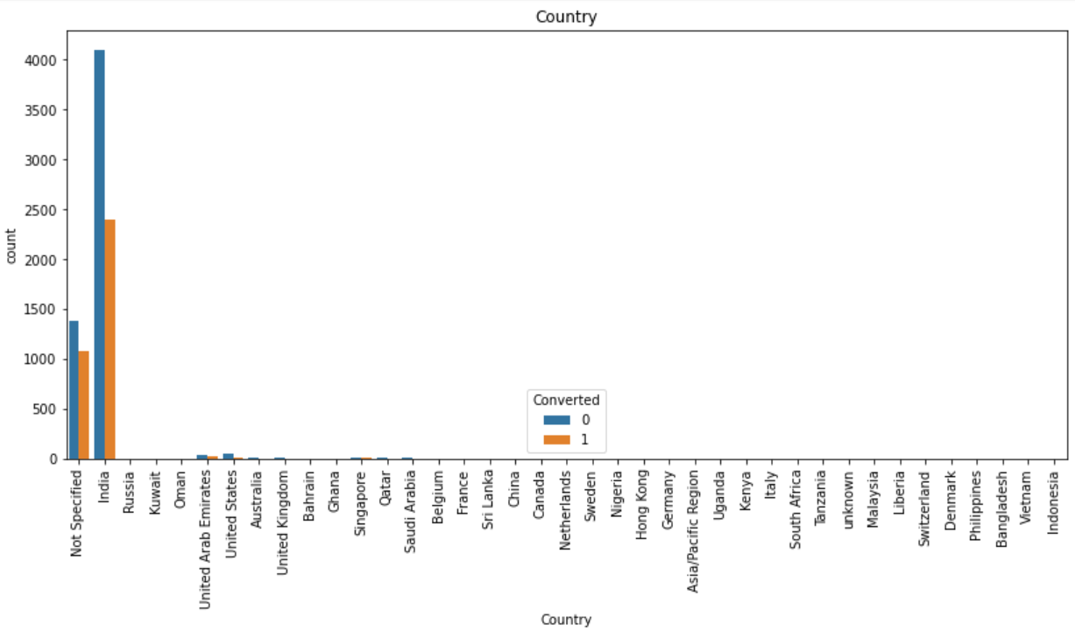
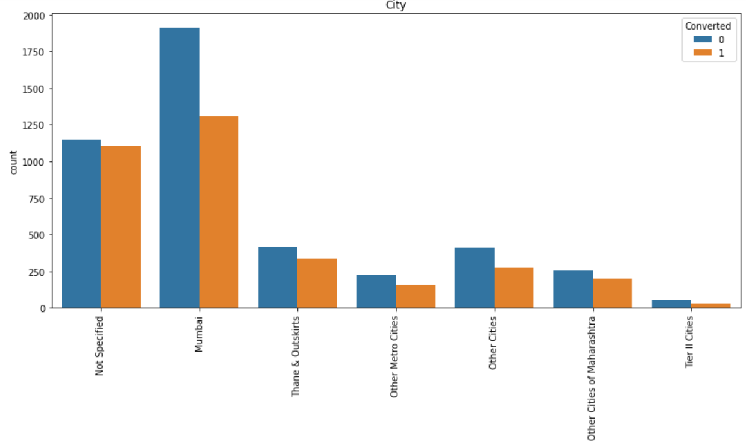
EDA – Bivariate and Multivariate Analysis
Mostly people are either from India or are Not specified. The proportion of these variables is so much that it becomes almost irrelevant. For our study, we will focus on the Indian clients primarily.
People who haven't specified their cities(Mostly may be from tier-2, 3 cities) are the leads with a good conversion ratio followed by Mumbai, Thane and outskirts.

Slide 8
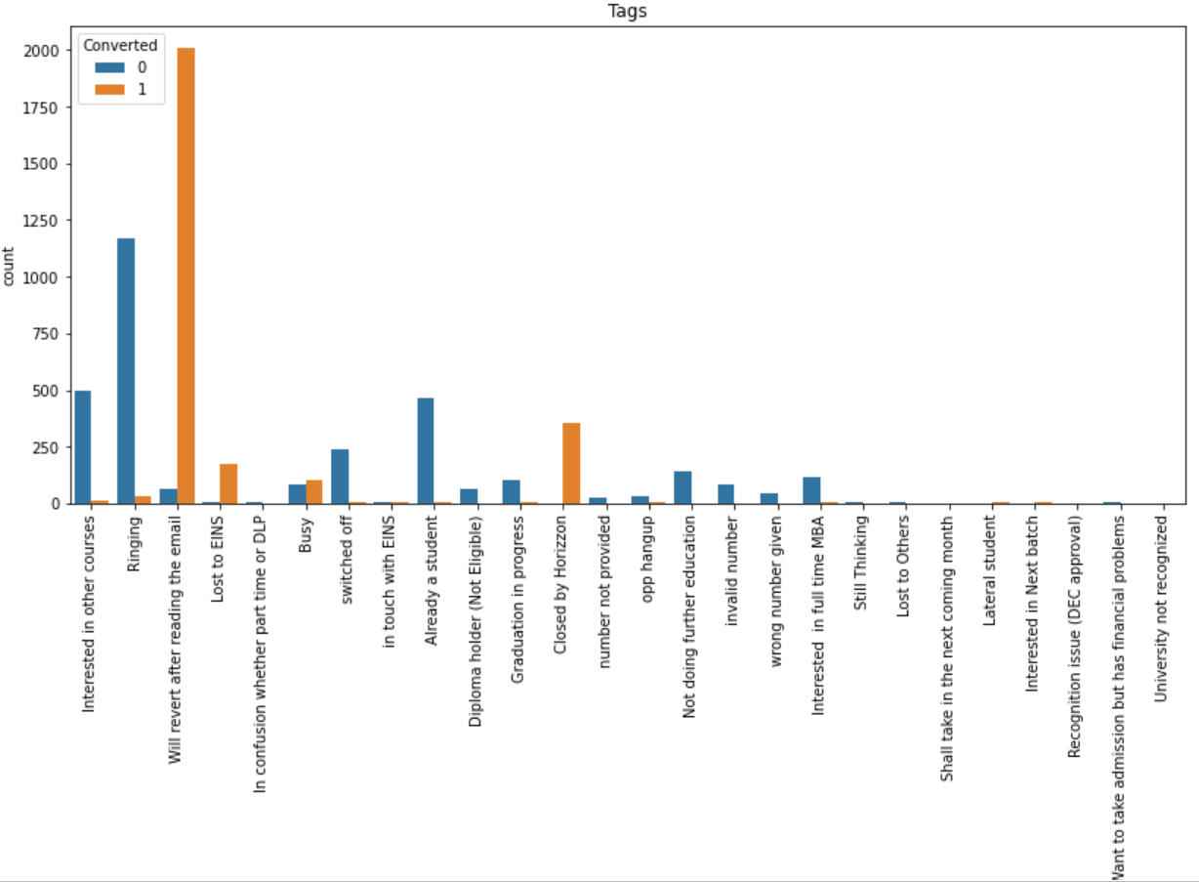
EDA – Bivariate and Multivariate Analysis
People who are given tags like 'Will revert after reading the email' are the most and the rate of conversion is almost 2000/2050 which is great.
Such conversions are later followed by 'Closed by Horizon' or 'Lost to EINS’ with almost same conversion rate but counts are small.

Slide 9
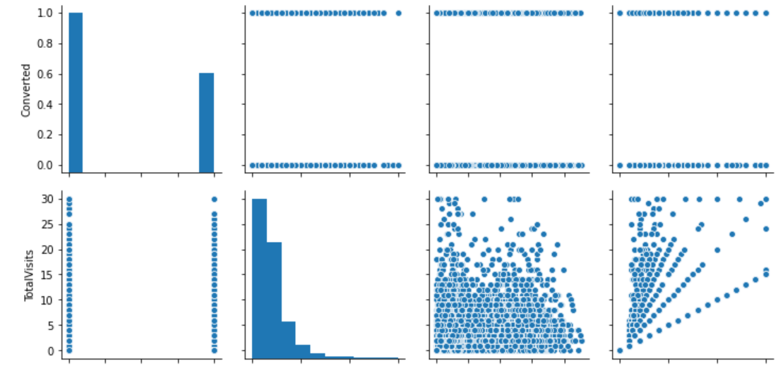
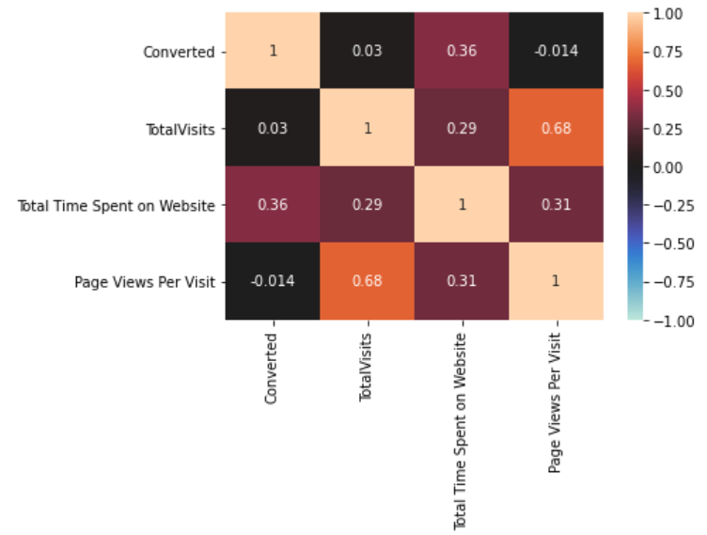
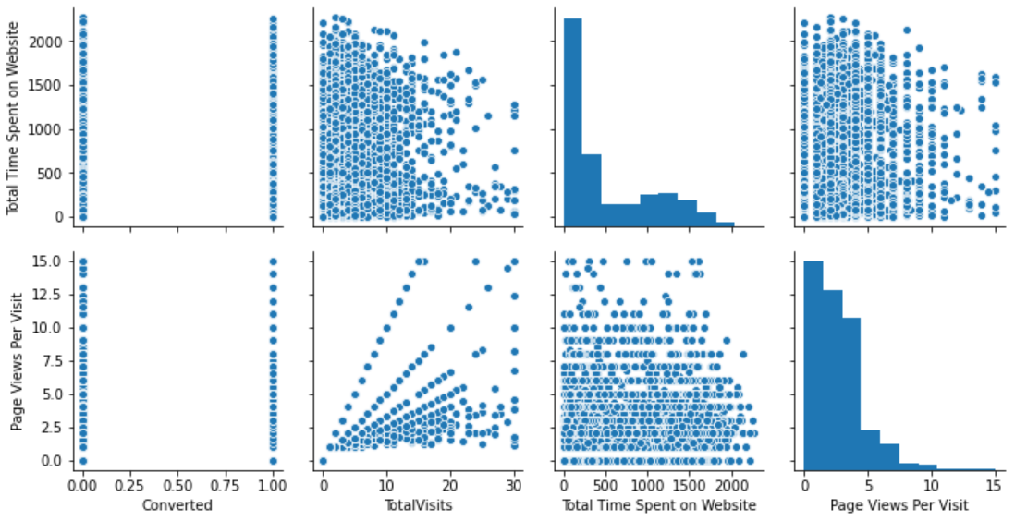
EDA – Bivariate and Multivariate Analysis
The amount of time spent, page views and total visits to the website all exhibit high correlation amongst each other.
The conversion rate is higher for a person spending more time on the website.

Slide 10
Modeling - Data Preparation
Dummy variable creation:
– We converted the Yes/No variables to 1 and 0 respectively.
– Converted the remaining categorical variables to dummy variables.
Train-Test split – Split the data set into training and test data in 7:3 ratio.
Standardization: We rescaled the variables using StandardScaler.

Slide 11
Modeling – Recursive Feature Elimination
We tried 3 different models using different number of variables each time(25,20 and 15 respectively).
The variables after elimination were based on p-value check (p value > 0.05) and VIF scores (<5). Both the values were brought within range for all the features.

Slide 12
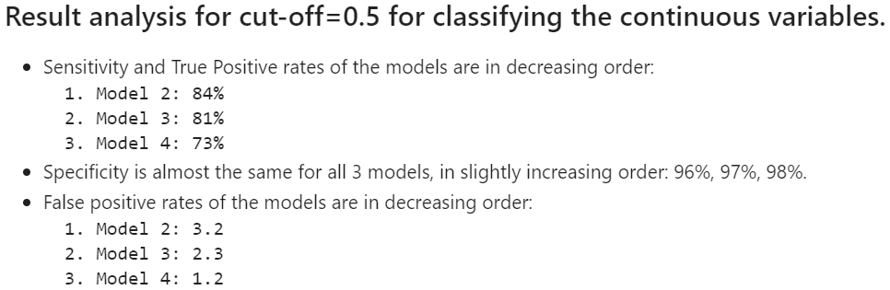
Model Evaluation
After computing the confusion matrix for the three models, we obtained the below result:

Slide 13
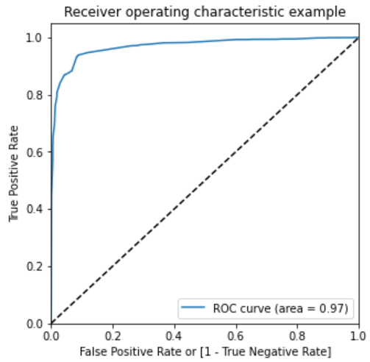
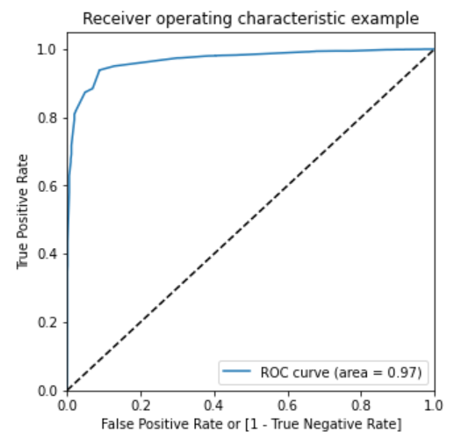
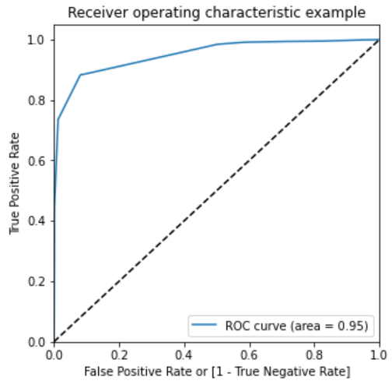
ROC Curve
Model-25var Model-20var Model-15var
The area under the curve value lies between 0.5 to 1 where 0.5 denotes a bad classifier and 1 denotes an excellent classifier.
As we can see, the AUC value is close to 1, so we can be confident that the models are apt for logistic regression.

Slide 14
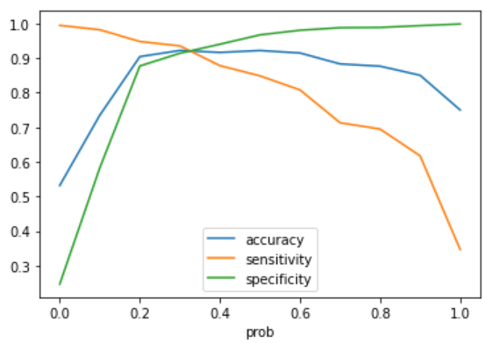
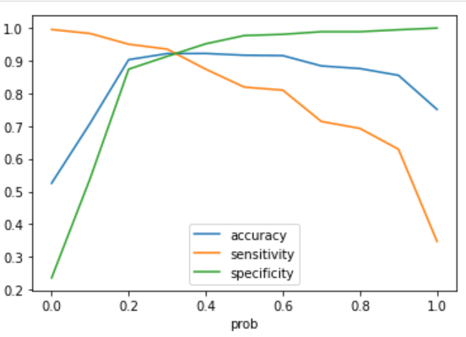
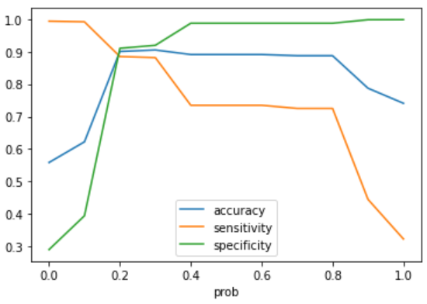
Optimal cut-off value for Classification
Model-25var Model-20var Model-15var
The graph is plotted for cut-off values ranging from 0.1 to 1.
The optimum cut-off value from the graph is 0.3, 0.3 and 0.2 for the models respectively.

Slide 15
Conclusions
Sensitivity and Specificity was same for Model-25var, Model-20var and Model-15var when the cutoff for predicted value conversion was assumed 0.5.
ROC curve gave better and almost identical results for Model-25var and Model-20var compared to Model-15var
The optimum cutoff derived for Model-25var, Model-20var and Model-15var was 0.3, 0.3 and 0.2 respectively. 0.2 optimum cutoff meant better chances of predicting the lead conversion correctly.
Model-25var and Model-20var ended up being the best models for prediction but since the number of variables are lesser in Model-20var – we selected Model-20var for prediction.

Slide 16
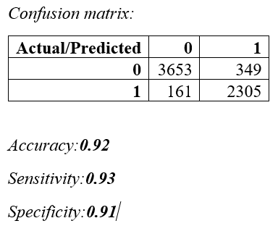
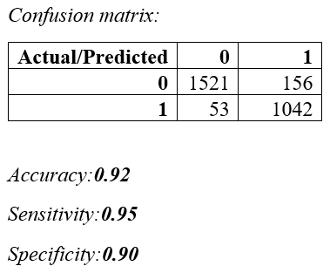
Conclusions
Final model when run on train and test data, gave us:
Train Data Test Data
We can conclude that this model will not only take care to not miss the Leads having the potential to get Converted, but will also save money by not predicting false leads.

Slide 17
Conclusions and Recommendations
The variables in our model which contribute most towards the probability of a lead getting converted are as below (in ascending order i.e. the strongest predictor first)
0.6311 (Tags_Lost to EINS)
0.5537 (Tags_Closed by Horizon)
-0.5211 (Tags_wrong number given)
-0.5098 (Tags_switched off)
-0.4968 (Tags_Ringing)
-0.4938 (Tags_number not provided)
-0.4914 (Tags_invalid number)
-0.4413 (Tags_Diploma holder (Not Eligible))
0.4294 (Tags_Will revert after reading the email)
-0.4158 (Tags_opp hangup)
…continued on the next slide

Slide 18
Conclusions and Recommendations
-0.4052 (Tags_Not doing further education)
-0.3951 (Tags_Interested in full time MBA)
-0.3765 (Tags_Already a student)
-0.3637 (Tags_Interested in other courses)
-0.3497 (Tags_Graduation in progress)
0.3117 (What is your current occupation_Unemployed)
0.3053 (Lead Source_Welingak Website)
0.2995 (What is your current occupation_Working Professional)
0.1572 (Last Activity_SMS Sent)
-0.1066 (Last Notable Activity_Modified)
More emphasis must be added to leads with tags such as Lost to EINS, closed by the Horizon or will revert after reading the mail.
Also maximum focus amongst the Current occupation must be unemployed people and X education must start placement drives as well.
They must focus on leads whose last activities might involve sending SMS es to them.

Slide 19
Thank you

